Slide 1
Smart Buildings Implications on Accounting and Management Control: a Literature Review
Daniela Mancini, Arianna Petrosino, Palmira Piedepalumbo,
Elisabetta Magnaghi

Slide 2
Agenda
Motivations
Aims
Methodology
Literature analysis: sources and smart buildign concept
Literature analysis: smart building models
Literature analysis: topics and management issues
Discussion
Possible implications

Slide 3
Motivations
Smart Technologies
Smart & Green Convergence
Sustainability
EU smart strategies
Digitalization of organisational processes
EU 2020 policy
Smart approach to sustainable development
Smart building for energy transition
Corporate Sustainability strategies
Building consumed a great amount of energy
Advances in technological innovation
Energy and Societal Transition Project
Smart & Sustainability University Strategy

Slide 4
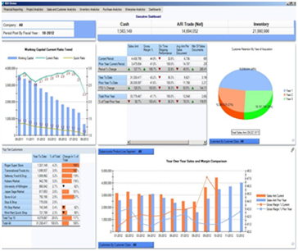
Aims
How could smart building impact
Management Control
Accounting

Slide 5
Methodology
I) Preliminary literature search
WOS and Scopus database
II) Refining literature search
«smart* building*» and «intelligent building*»
III) Literature review
Reading of the articles
«smart* building*» keyword
No restriction by subject
Classification by topics and other features
Restriction to Business and Management subject
Identification of keywords
Multi-disciplinary search
8 scientific article in business and management
Smart building concept
Point of view
IT focus
Management concern
Accounting and control issues

Slide 6
Literature analysis: sources and smart building concept
n. | keyword | definition | author/s
1 | intelligent building | Intelligent buildings is those buildings that make extensive use of information technology for building applications, and business applications, and that are responsive to organisational and technological change. | Oades, 1989
2 | intelligent building | It is a building which creates an environment that maximises the efficiency of the occupants of the building while at the same time allowing effective management of resources with minimum lifetime costs. [...] | Robathan, 1991a
3 | intelligent building | The interconnection of devices, actuators, monitors and control units to form a unified system of control for a building or campus appears to be the perfect solution to achieving the intelligent building. | Robathan 1991b
4 | intelligent building | Intelligent building have come into the spotlight recently and they will require an ever more specialised approach to building maintenance as a result of the complex integration of various systems including fire, security, access, air conditioning and communications. | Sidney, 1992
5 | intelligent building | Thus, it is the performance of the intelligent building that is important and what intelligence does is manage the interfaces between the building, the organisation and the user, now and in the future. [...] As well as the integration of the building, organisation and the user, an intelligent building must work within the global and local environmental constraints. In this way the building can respond to future changes in legislation and social expectations and provide a healthy environment for its users. | Boyd et al., 1993
6 | smart building | The addition of micro-electronic devices, such as sensor, can enable the setting up and operation of the so called smart buildings and smart ships. | Fox et al., 2013
7 | smart building | Smarter building the use of sensor to collect data and develop analytics for identifying energy saving opportunities in building by modelling and analyzing how energy is consumed in buildings. | Lee et al., 2014
8 | smart building | Iot-based application have opened up a growing market for smart building, intelligent building or smart-home projects and business models. [...] The mosaic of involved layers and components of the system, specifically: (1) the sensing, delivery and management layer [...]; (2) the data processing and modeling layer [...]; the smart building services buildings layer [...]. The entire building would be completely covered by the smart devices, which control all the intra-activities of resident and objects. This also facilitates the inter-system connection with other parties’ systems inserted such as a services providers, local authorities and other peripheral actors, which ultimately constitutes the larger ecosystem of smart-areas or even smart cities. | Le et al., 2019

Slide 7
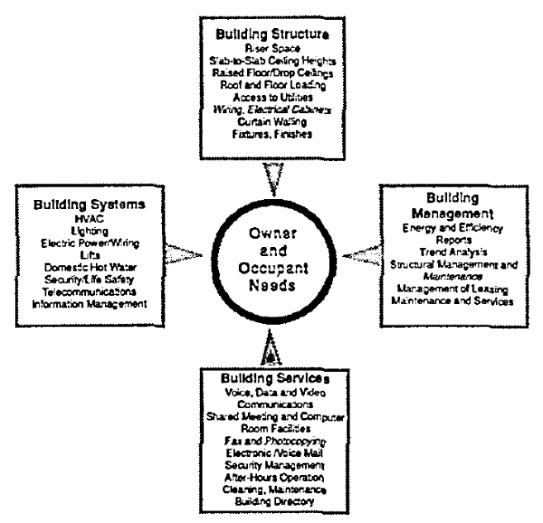
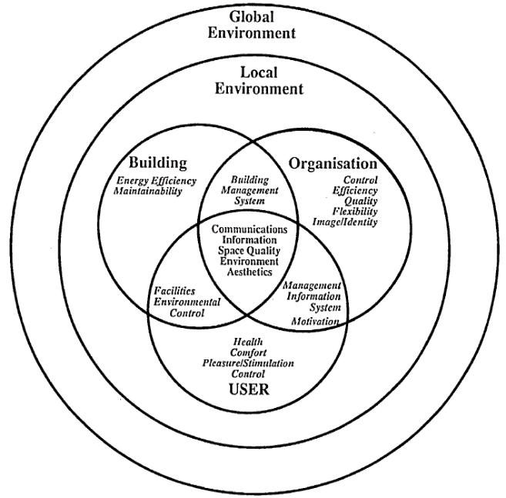
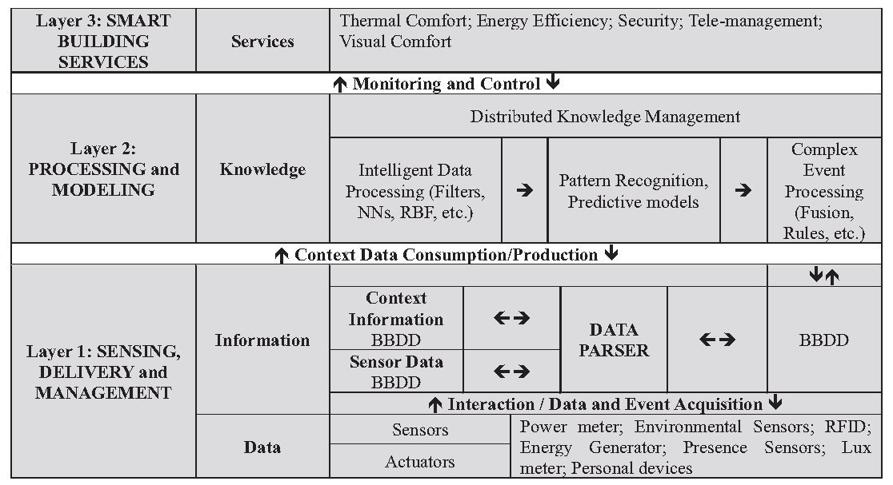
Literature analisys: smart building models
Robatan (1991a)
Boyde (1993)
Le et al. (2019)
IB like the human body
IB is an intelligent interface
SB is made by three layers

Slide 8
Literature analysis
Point of view | IT focus | Management Concern | Accounting and Management Control issues | Author/s
property professionals | cabling infrastructure | the introduction in the traditional building team of cabling specialists | asset not a overhead, flexibility and obsolescence, different life span, life cycle approach, efficient, effective planning and management of the cable system | Oades (1989)
occupants, managers of the building, owners, developers involved in creating the building | telecommunications and networking internal, external, and integration with other services through a common cabling scheme and a unified cabling infrastructure | integrated management of building services and central control of building facilities to respond to environmental changes in an effective way | quality of control of services and facilities and systems, feedback provided by the infrastructure, control over cost/performance of building systems, planning and control of maintenance. | Robathan, 1991a
clients of building control industry | open protocols for integrated communication between the individual components of a IB | improve the communication between systems and devices at all level within an organization, cost of building control system | take under control the cost of integration of different devices and objects | Robathan 1991b
maintenance contractors/property managers | Computerised maintenance system | planning preventive and reporting the costs and activities of maintenance | planning and control of the cost of maintenance services and retention of building value over time | Sidney, 1992
resident organisation and users |  | management intelligent building transition by refurbishment | building performance measurement according different kind of needs, costs and value of refurbishment | Boyd et al., 1993
project businesses | microelecronics devices | use of BIG Data achieving informational and transformational effects | costs of the implementation and management of technological systems, cost opportunities, predictive models for mantainace services, remote monitoring and reporting of the performance in use, supply chain relationships | Fox et al., 2013
building managers, operators and tenants facilities managers municipalities | analitics and predictive model based on a matematic, statistic and fisic model | use of analytics to identify energy savings opportunities in buildings | understand the patterns of energy usage, understand how occupants behaviours affect energy consumption, simulate the impact of possible changes, visualize building energy performance | Lee et al., 2014
facilities management companies | smart platform for facilities services coordination the platform connect owners, tenants, and third parties (services companies) | design of a business model | collect insight on users behaviours for building services offers | Le et al., 2019

Slide 9
Discussion
Lack of a general shared definition of smart buildings: equipment-centred; performance-centred; inteconnection-centred
Literature on smart building is almost silent about its implications on accounting and management control
The smart building issue is essentially analysed from the perspective of users, little attention is focus on firms that adopt a smart and sustainbility strategy
Smartization of buildings implies the asset transformation from tangible to intangible/hybrid
Complexity of the smart building: many different devices to collect varius data
Necessity to manage in an effective way the cost of manteinance and costs of facilities

Slide 10
Possible implications
Accounting
Management control
Completion
Information ecosystem span
Evaluation methods
New information sources
New measures for behavioural control
Smart Building as an Asset: from traditional tangible asset to an hybrid one
New opportunities for investment and operational cost budgets/cost accounting: results control
Implication on «environmental» cultural control

Slide 11
Thank you for your attention
Daniela Mancini
mancini@uniparthenope.it
?
Questions

